Slide 1

Amigo
A Chatbot for Cloud Operations Management
May 16, 2017
San Jose State University
Swetha Muchukota
Chetan Punekar
Watsh Rajneesh
Ashutosh Sharma

Slide 2
Opportunity Addressed
Amigo Chat-Bot brings multi-cloud management to enterprise messengers, like Slack.
It makes it more convenient for teams to collaborate and carry forward DevOps culture.

Slide 3
The Idea and How it Works
Amigo integrates with Slack enterprise messenger
Provides Web UI, Mobile App and a CLI for user registration
User profile consists of :
Slack User ID
Cloud provider credentials
Amigo’s backend uses Natural Language Processing (NLP) to derive the intent from the user’s message
Each intent is mapped to a cloud provider specific CLI command
Cloud provider CLI command is executed and response is sent back to Slack

Slide 4
Unique Benefits
Amigo Chatbot service brings multi-cloud management to enterprise messengers, like Slack. It can be extended to support new cloud providers and enterprise messengers.
Enables fast response to incidents occurring in managed cloud environments leveraging integrations of third party monitoring solutions with enterprise messengers like Slack.
Built-in archiving of all actions performed.
Operations can be performed from Web UI, Mobile Apps or desktop clients of enterprise messengers.
Operations can be performed without requiring corporate VPN access as enterprise messenger services are SaaS services accessible outside of the VPN.

Slide 5
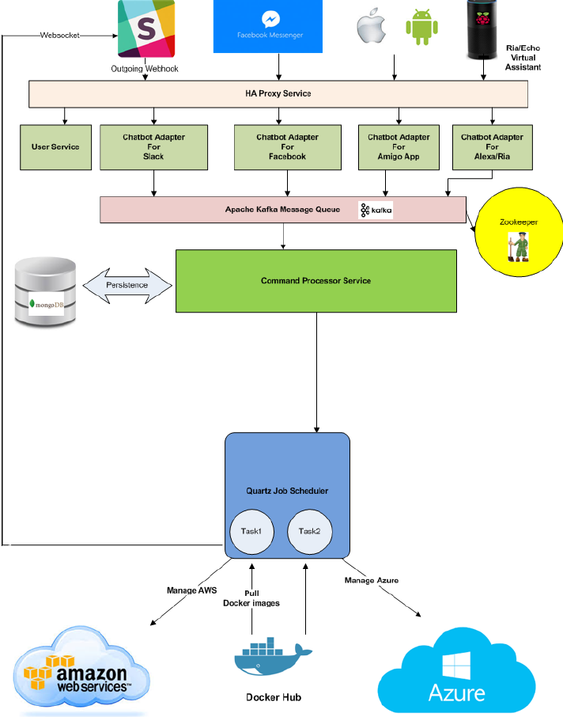
Architecture
Slack user sends message to Slack adapter
Slack adapter publishes the message to Apache Kafka topic
Command processor service receives the message from the topic and spawns a job
Message processing job infers the intent and command from the message and the corresponding cloud provider.
It pulls the right cloud provider CLI docker image from docker hub.
Uses the cloud provider CLI to execute the command.

Slide 6
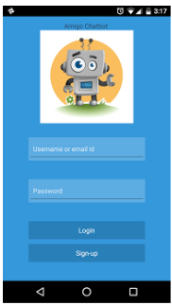
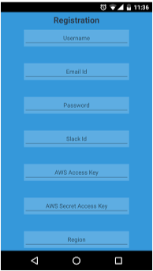
User Profile
User registration with Amigo Chatbot services is required before user can interact with the bot in Slack UI.
User profile is registered using Mobile App, Web UI or CLI.
It has the following information:
Name
Email
Slack User ID
RIA Device ID
Password
AWS Credentials

Slide 7
Slack Integration
User types message to list the ec2 (AWS Elastic compute) availability zones
Backend finds matching intent from the message and the corresponding command to execute.
Response is shown to the user in slack messenger.

Slide 8
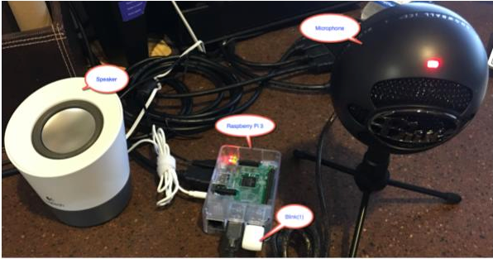
Raspberry Pi Intelligent Assistant (RIA)
RIA is a voice assistant that user can speak the command to and it performs the action via Amigo Chatbot service.
It uses Blink(1) device to show the status of active listening (flashing white), success (green) or failure (red).
The figure shows components of RIA.

Slide 9
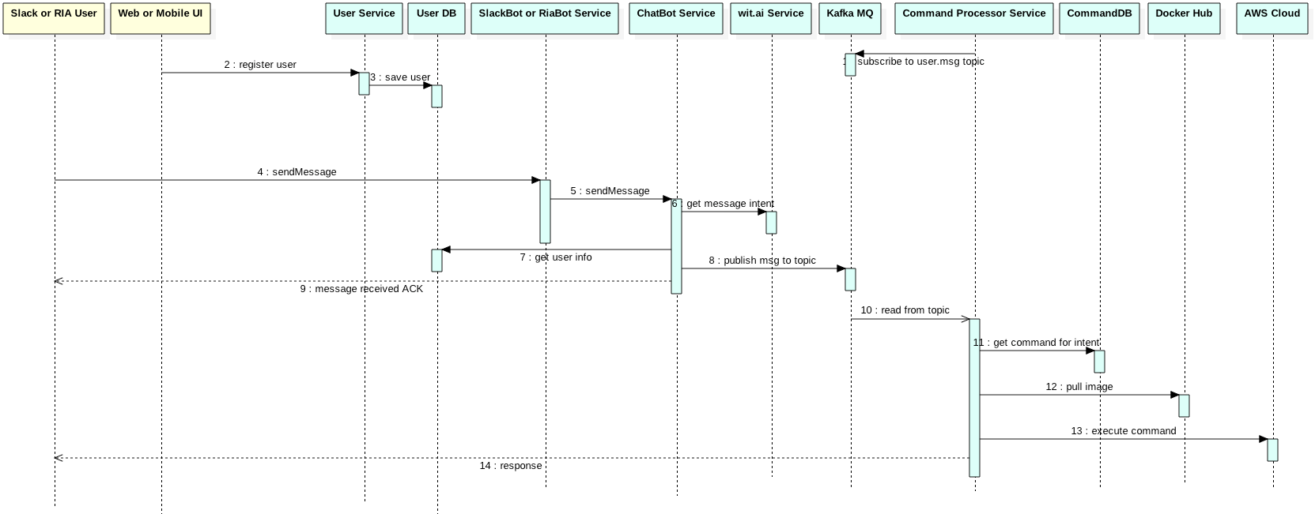
Amigo Service Sequence Diagram

Slide 10
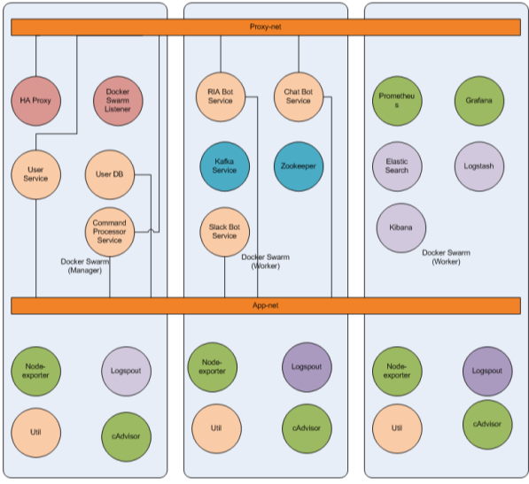
Amigo Microservices
Each blob in the figure is a microservice running as docker container within Docker Swarm cluster.
Docker overlay networks exist to connect the services.
Several infra services are required to monitor and manage the application microservices:
RED blobs are HA Proxy Services – that perform request routing.
GREEN blobs are running monitoring infra services.
PURPLE blobs are logging infra services.
BLUE blobs are message queue related services.
ORANGE blobs are Amigo application microservices.

Slide 11
Problems Encountered, Solutions
Problems encountered:
Debugging microservices when they run within a container orchestrator (like Docker Swarm) is painful.
Docker logs will only show last all or N number of lines and don’t tail live.
Running dockerized applications in debug mode requires extra tooling support from IDE so it can connect to the debugger agent on a container within the Swarm cluster.
Solutions:
We deployed the microservices running as separate processes on different ports on the local dev host to ease debugging.

Slide 12
Lessons Learned, Potential Improvements
Lessons Learned:
Integration with enterprise messengers like Slack
Developing microservices to run as docker containers
Deployed in Docker swarm mode clusters
Developing Mobile app using React Native
Developing Web application using React.js
Hosted in AWS public cloud
Potential Improvements:
Add support for other cloud providers: docker-cloud, gcloud, azure-cli
Use Amazon Lex to write a wrapper bot thus extending Amigo’s features to several enterprise messengers.
Add support for voice assistants like Amazon Alexa and Google Home.

Slide 13
Summary, Credits
Summary:
Amigo Chatbot is highly scalable (supporting several hundreds of users), reliable (ensuring no user message is dropped) and secure service that enables management of multiple cloud provider environments from enterprise messenger services.
Project sources available at: https://github.com/sjsucohort6/amigo-chatbot
Project report at: Amigo Project Report
Credits:
Project Advisor | Professor Andrew Bond
Development Team
Swetha Muchukota | Chetan Punekar
Watsh Rajneesh | Ashutosh Sharma

